Slide 1
Titanic Passenger Analysis
May 2025
Norma Winters
Cell Phone 616-719-7456

Slide 2
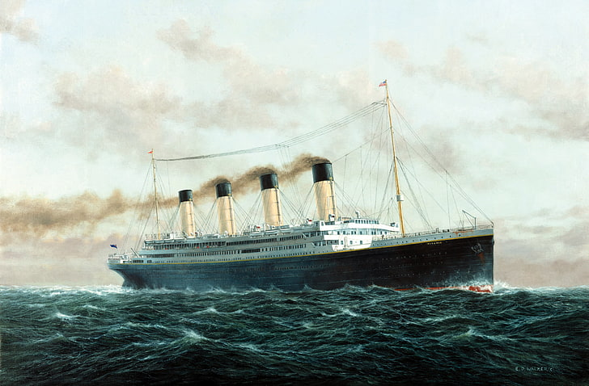
The Voyage
A historical, tragic end to the journey across the ocean on April 1912
Data analysis was completed using the Seaborn Titanic Library, which details passenger data.
Python, Numpy, pandas, Matplotlib
https://codesignal.com
Clauda AI https://claude.ai/
Waskom, M. L., (2021). seaborn: statistical data visualization. Journal of Open Source Software, 6(60), 3021, https://doi.org/10.21105/joss.03021.
Notes:
Seaborn Library data set Titanic
Passenger information from the Titanic, including survival status, class, age, gender, etc.
Data analysis was completed using the Seaborn Titanic Library, which details passenger data.
Survival status (survived or died)
Passenger class (1st, 2nd, or 3rd class)
Name
Sex
Age
Number of siblings/spouses aboard (sibsp)
Number of parents/children aboard (parch)
Ticket number
Passenger fare
Cabin number
Port of embarkation (C = Cherbourg, Q = Queenstown, S = Southampton)
Analysis was completed using
Python
numpy
pandas
matplotlib
Waskom, M. L., (2021). seaborn: statistical data visualization. Journal of Open Source Software, 6(60), 3021, https://doi.org/10.21105/joss.03021.

Slide 3
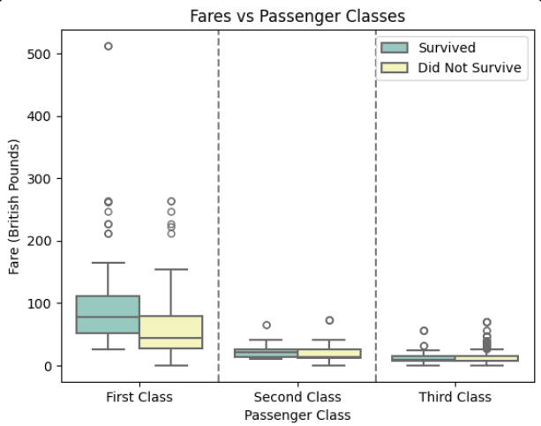
Compare price, class and survival
The most expensive ticket was over 500 British pounds and was a survivor.
Only in first class did the price make a difference in survival.
Notes:
print(titanic_df.info())
# Column Non-Null Count Dtype
--- ------ -------------- -----
0 survived 891 non-null int64
1 pclass 891 non-null int64
2 sex 891 non-null object
3 age 714 non-null float64
4 sibsp 891 non-null int64
5 parch 891 non-null int64
6 fare 891 non-null float64
7 embarked 889 non-null object
8 class 891 non-null category
9 who 891 non-null object
10 adult_male 891 non-null bool
11 deck 203 non-null category
12 embark_town 889 non-null object
13 alive 891 non-null object
14 alone 891 non-null bool
print(titanic_df.describe())
survived pclass age sibsp parch fare
count 891.000000 891.000000 714.000000 891.000000 891.000000 891.000000
mean 0.383838 2.308642 29.699118 0.523008 0.381594 32.204208
std 0.486592 0.836071 14.526497 1.102743 0.806057 49.693429
min 0.000000 1.000000 0.420000 0.000000 0.000000 0.000000
25% 0.000000 2.000000 20.125000 0.000000 0.000000 7.910400
50% 0.000000 3.000000 28.000000 0.000000 0.000000 14.454200
75% 1.000000 3.000000 38.000000 1.000000 0.000000 31.000000
max 1.000000 3.000000 80.000000 8.000000 6.000000 512.329200
Code -----------------------------------------------------------------------------
import matplotlib.pyplot as plt
import seaborn as sns
titanic_df = sns.load_dataset('titanic')
titanic_df['class_label'] = titanic_df['pclass'].map({1: 'First Class', 2: 'Second Class', 3: 'Third Class'})
titanic_df['survived_label'] = titanic_df['survived'].map({1: 'Survived', 0: 'Did Not Survive'})
sns.boxplot(
x='class_label', y='fare',
data=titanic_df,
palette='Set3', linewidth=1.5,
order=['First Class', 'Second Class', 'Third Class'],
hue='survived_label',
hue_order=['Survived', 'Did Not Survive'],
color='skyblue', saturation=0.7,
dodge=True, fliersize=5
)
plt.legend(loc='upper right', title=None)
plt.ylabel('Fare (British Pounds)')
plt.xlabel('Passenger Class')
plt.axvline(x=0.5, color='gray', linestyle='--')
plt.axvline(x=1.5, color='gray', linestyle='--')
plt.title('Fares vs Passenger Classes')
plt.show()
Explanation-------------------------------------------------------
This code creates a box plot using the Titanic dataset to visualize the
relationship between passenger class (pclass), fare prices, and survival status.
The plot has:
The x-axis showing passenger class (1st, 2nd, and 3rd class, ordered specifically as specified in order=[1,2,3])
The y-axis showing fare prices paid by passengers
Different colors for survived (1) and not survived (0) passengers, with survived passengers shown first due to hue_order=[1,0]
A custom color palette ("Set3") with distinct colors to differentiate survival status
A title "Fares vs Passenger Classes Differentiated by Survival“
Key insights this visualization would reveal:
The relationship between passenger class and fare prices (1st class being most expensive, 3rd class least expensive)
Fare distribution within each class (the box shows median, quartiles, and the whiskers show the range)
Whether there's a pattern between fare prices and survival rates within each class
Outliers in fare prices (shown as individual points beyond the whiskers)
Visualization for examining how economic factors (ticket price and class) correlated with survival outcomes. The dodge=True parameter ensures that the boxes for survived and not survived are placed side by side for easier comparison within each class.

Slide 4
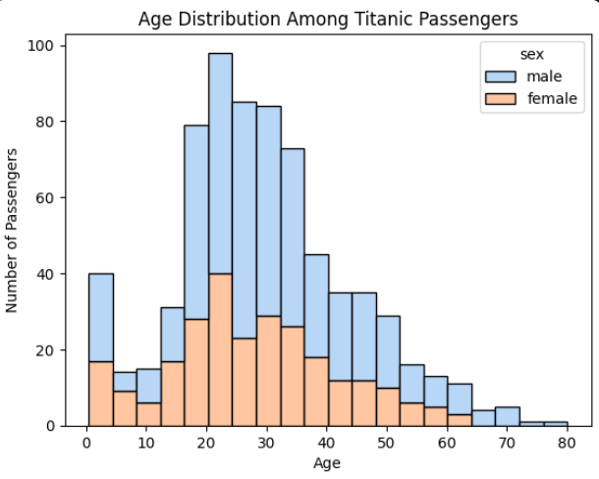
Age and Sex Distribution
In each age grouping, there are more males.
There is a significant jump in age between 20 to 40.
Notes:
The stacked histogram demonstrates the overall age distribution of Titanic passengers and the gender breakdown within each age range.
Age Distribution
In each age grouping, there are more males.
There is a significant jump in age between 20 to 40.
-----------------
Code
import matplotlib.pyplot as plt
import seaborn as sns
titanic_df = sns.load_dataset('titanic')
sns.histplot(data=titanic_df, x='age', hue="sex", multiple="stack", palette="pastel")
plt.title('Age Distribution Among Titanic Passengers')
plt.xlabel('Age')
plt.ylabel('Number of Passengers')
plt.show()

Slide 5
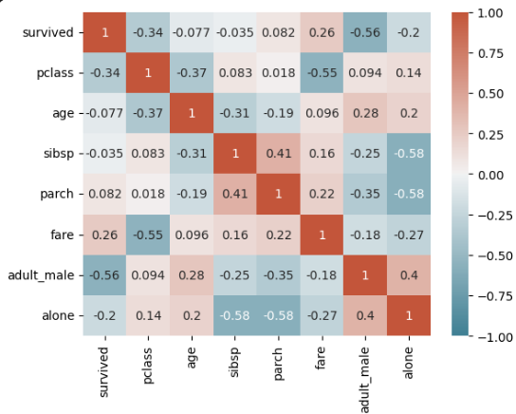
Titanic Correlation
Positive Numbers represent the correlation between the fields in the same direction
>
>
Negative Numbers represent a correlation in the opposite direction.
<
>
Notes:
Correlation Matrix Heatmap Code Analysis
This Python code creates a correlation matrix heatmap visualization for the Titanic dataset.
Code
import matplotlib.pyplot as plt
import seaborn as sns
titanic_df = sns.load_dataset('titanic')
correlation_matrix = titanic_df.corr(numeric_only=True)
color_map = sns.diverging_palette(220, 20, as_cmap=True)
sns.heatmap(correlation_matrix, annot=True, cbar=True, vmin=-1, vmax=1, cmap=color_map)
plt.show()
First, it imports the necessary libraries: matplotlib.pyplot for plotting and seaborn for enhanced data visualization.
It loads the built-in Titanic dataset from seaborn with sns.load_dataset('titanic').
It calculates the correlation matrix between all numeric variables using titanic_df.corr(numeric_only=True).
It creates a diverging color palette (blue to red) for the heatmap with sns.diverging_palette(220, 20, as_cmap=True).
It visualizes the correlation matrix as a heatmap with:
annot=True to display the correlation values in each cell
cbar=True to include a color bar legend
vmin=-1, vmax=1 to set the color scale range for correlations
The custom color map defined earlier
Finally, it displays the plot with plt.show().
The heatmap will show the strength of relationships between numeric variables in the Titanic dataset, with positive correlations in one color and negative correlations in another. On the right is a color index to interpret the heat map.

Slide 6
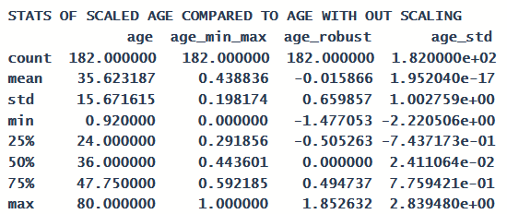
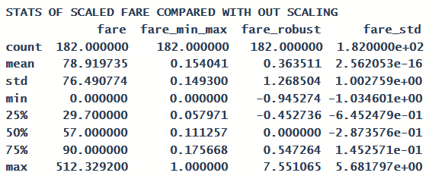
Data Transformation and Scaling
First drop rows that have null values
The value 1.820000e+02 is just scientific notation for 182.0, which means there are 182 rows in your dataset for the fare_std column.
This matches the number of rows after dropping missing values.
Notes:
Why Use Scalers (In Simple Terms)
Scalers put all your numbers on the same scale so they can be compared fairly.
Why:
1. Equal playing field
If one feature ranges from 0-1 and another from 0-1000, the larger one might seem more important to the computer just because of its size.
2. Better performance
Many machine learning algorithms work better when all features are on similar scales.
3. Faster learning
With properly scaled data, algorithms can find patterns faster.
4. Different types for different needs:
MinMaxScaler: Puts everything between 0 and 1. Simple and easy to understand.
StandardScaler: Centers data around 0. Good for bell-curve shaped data.
RobustScaler: Handles outliers (unusual values) better than the others.
Think of scalers like translators that make sure all your data speaks the same language, making it easier for algorithms to understand the real patterns in your information.
Data Transformation and Scaling is done to get a clearer value of data statistics. It is used in machine learning.
Different types for different needs:
MinMaxScaler: Puts everything between 0 and 1. Simple and easy to understand.
StandardScaler: Centers data around 0. Good for bell-curve shaped data.
RobustScaler: Handles outliers (unusual values) better than the others.
Think of scalers like translators that make sure all your data speaks the same language, making it easier for algorithms to understand the real patterns in your information.
Code
------------------------
std_scaler = StandardScaler()
min_max_scaler = MinMaxScaler()
robust_scaler = RobustScaler()
titanic_df['age_min_max'] = min_max_scaler.fit_transform(titanic_df[['age']])
titanic_df['age_robust'] = robust_scaler.fit_transform(titanic_df[['age']])
titanic_df['age_std'] = std_scaler.fit_transform(titanic_df[['age']])
titanic_df['fare_min_max'] = min_max_scaler.fit_transform(titanic_df[['fare']])
titanic_df['fare_robust'] = robust_scaler.fit_transform(titanic_df[['fare']])
titanic_df['fare_std'] = std_scaler.fit_transform(titanic_df[['fare']])
print('STATS OF SCALED AGE COMPARED TO AGE WITH OUT SCALING')
print(titanic_df[['age','age_min_max', 'age_robust', 'age_std']].describe())
print('STATS OF SCALED FARE COMPARED WITH OUT SCALING')
print(titanic_df[['fare','fare_min_max', 'fare_robust', 'fare_std']].describe())

Slide 7
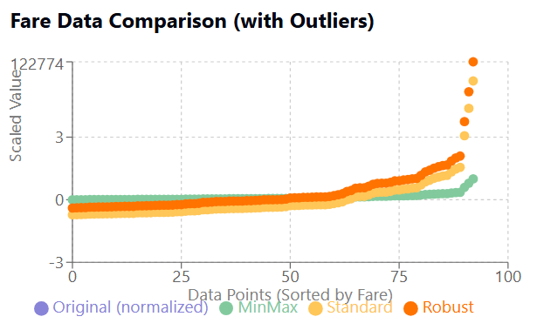
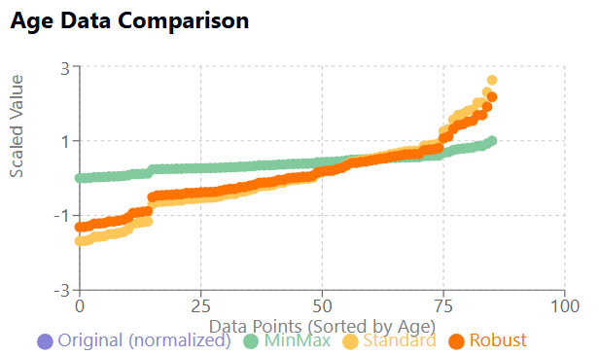
Comparison of scaling techniques.
The original data does not show up on chart because the original values would not fit in range.
Negative Numbers?
StandardScaler centers data around zero, so negative values mean those ages are below the mean.
RobustScaler centers data around the median and scales by the IQR, so negatives mean those ages are below the median.
The original age column should never have negatives, but the scaled columns can.
Notes:
Generated by Clauda AI
The original data does not show up on chart because the original values would not fit in range.
Negative Numbers?
StandardScaler centers data around zero, so negative values mean those ages are below the mean.
RobustScaler centers data around the median and scales by the IQR, so negatives mean those ages are below the median.
The original age column should never have negatives, but the scaled columns can.

Slide 8

Thank You
Contact: Norma Winters
Cell: 616-719-7456
Email: winters2nd@gmail.com
Top Skills: Database, Analytics, Programming, Project Management, Innovation, Quality, Visualization
Notes:
Contact: Norma Winters
Cell: 616-719-7456
Email: winters2nd@gmail.com
Top Skills: Database, Analytics, Programming, Project Management, Innovation, Quality, Visualization
My Why: I want my work to make an impact and provide a helpful tool that will be used to solve real-world business problems.
Personal Value Statement:

Slide 9
Skills
Why?
My Why: I want my work to make an impact and provide a helpful tool that will be used to solve real-world.
Value Statement
My mission is to transform complex data into actionable insights that drive strategic decisions while maintaining the highest standards of integrity and ethical practice. I am committed to delivering innovative database and analytics solutions that create lasting value through technical excellence and collaborative problem-solving.
Top Notch Skills: Database, Analytics, Programming, Project Management, Innovation, Quality
Notes:
Personal Values Statement
Data-driven decision making paired with human insight is at the core of my professional philosophy. I believe in leveraging analytical precision while maintaining a compassionate approach to leadership and innovation.
I value technical excellence and continuous learning, committing myself to mastering emerging database technologies and analytical methodologies. I embrace complexity as an opportunity to develop elegant solutions that drive business value.
Transparent communication is fundamental to my approach, ensuring that technical insights are translated into actionable knowledge for all stakeholders. I champion ethical data practices, respecting both privacy and the power of information to transform organizations.
As a leader, I foster collaborative environments where diverse perspectives enhance our collective problem-solving capabilities. I believe innovation thrives when team members feel empowered to contribute their unique expertise.
I am committed to delivering measurable results while maintaining unwavering integrity in all aspects of my work. My ultimate aim is to create sustainable systems and processes that adapt to changing needs while consistently delivering excellence.

